Slide 1
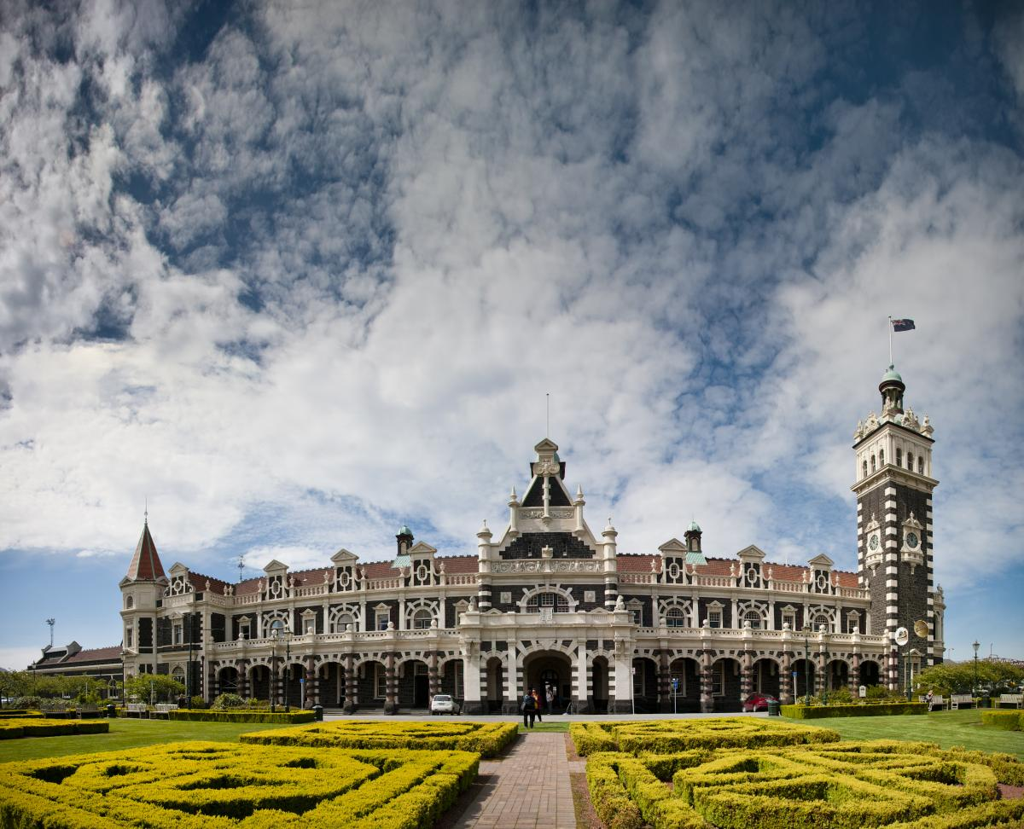
Dunedin Railways
Volunteer Management Tool

Slide 2
Points to Clarify
Similar services : http://www.volunteeringotago.org.nz/
Manpower and budget:
How the current system is upkept
Server costs regarding traffic
Why now?

Slide 3

Project Goal
To create a database of Dunedin Rail volunteers and volunteer jobs and supplement this with website and email features.

Slide 4
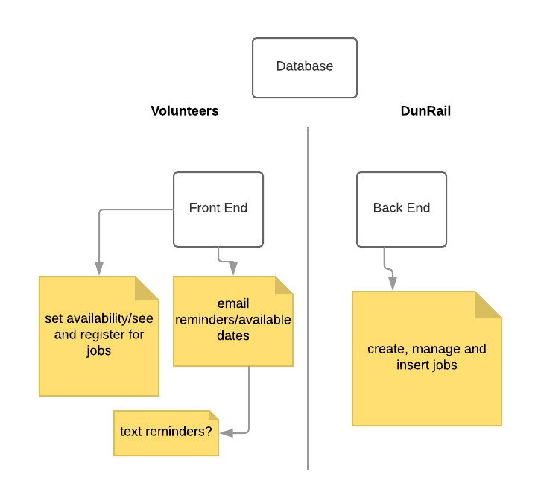
Visualising
Whole project
The data
Managing the data
Automating things
Triggers
Volunteer things
Couples
Special needs
Safety
Debrief

Slide 5
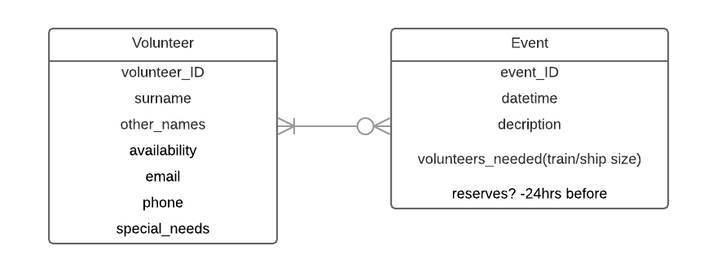

Slide 6
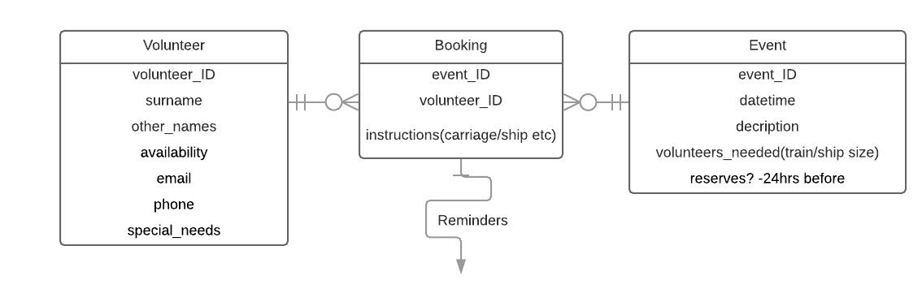

Slide 7
Next steps
Timeline
...

